Slide 1

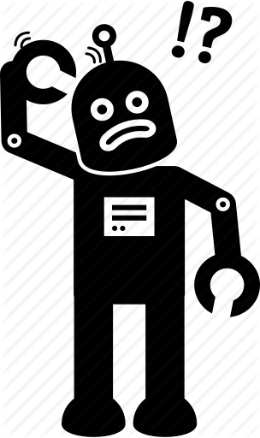
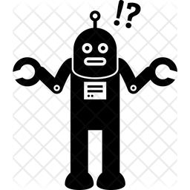
Common mistakes and misconceptions in AI & ML
-BY Rinki Nag

Slide 2


Five misconceptions and mistakes which happens to be in mind of budding AIML engineer & how to overcome them

Slide 3
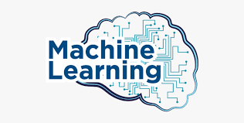

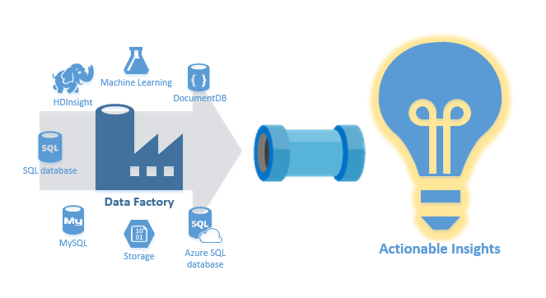
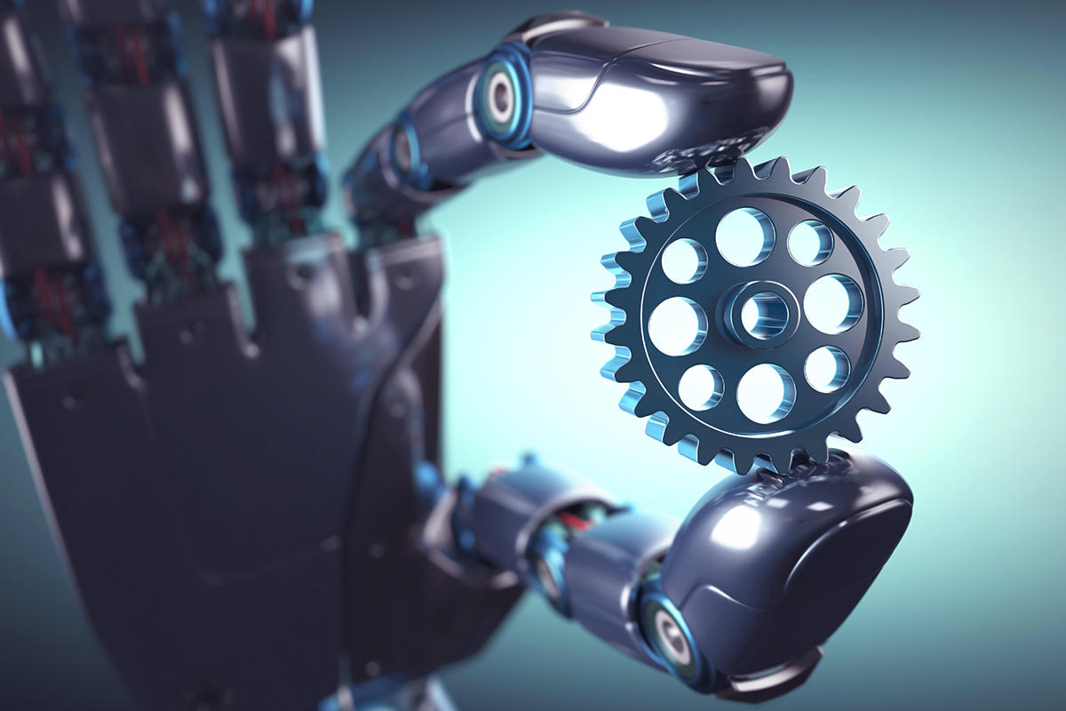
1. Building models is most superior and cream layer job
No It’s A Pyramid

Slide 4

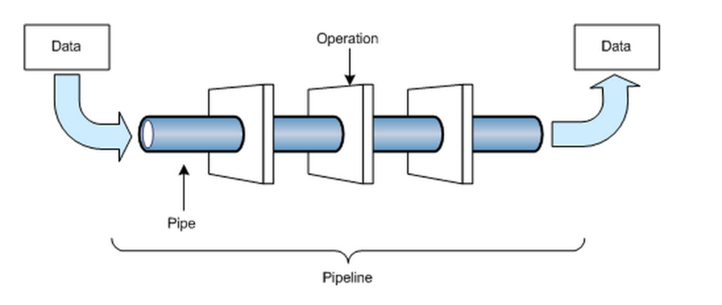


2. Data engineering is not a sexy job like data scientist

Slide 5
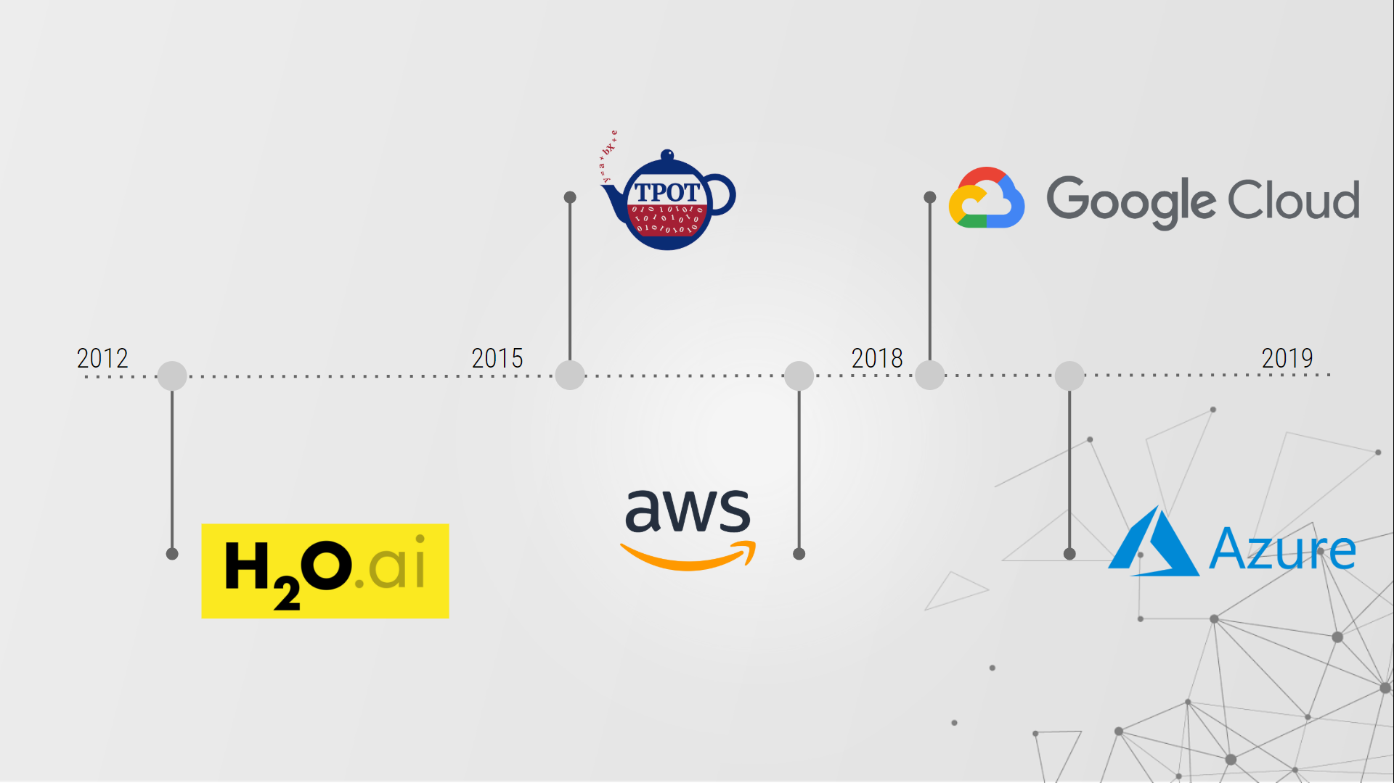
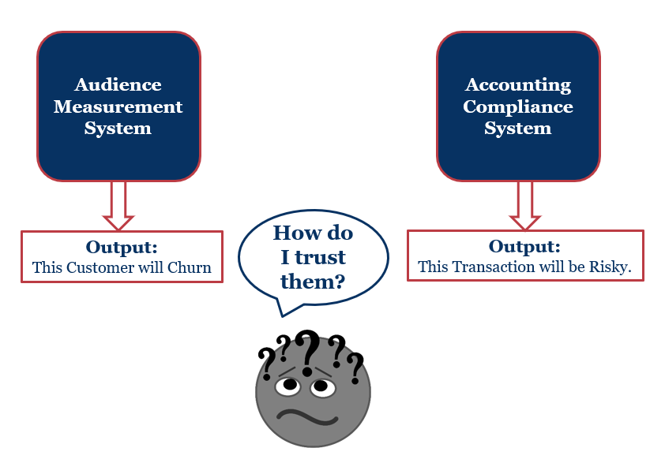
3. Ignoring The Importance Of Explainable AI In ML models and fearing Auto ML
Note : Black box always don’t do the magic

Slide 6


4.Ignoring to measure the business success or feedback loop for ML models

Slide 7
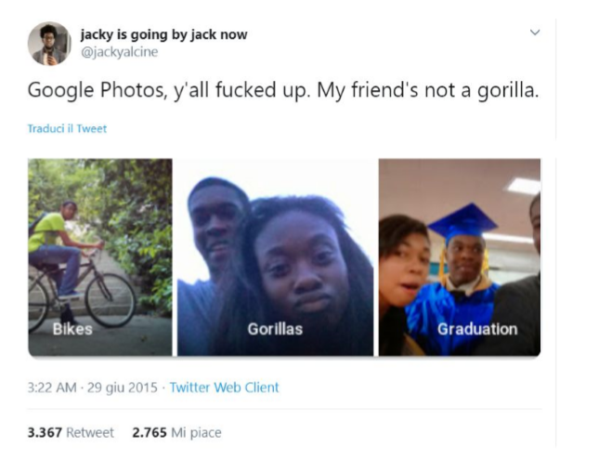
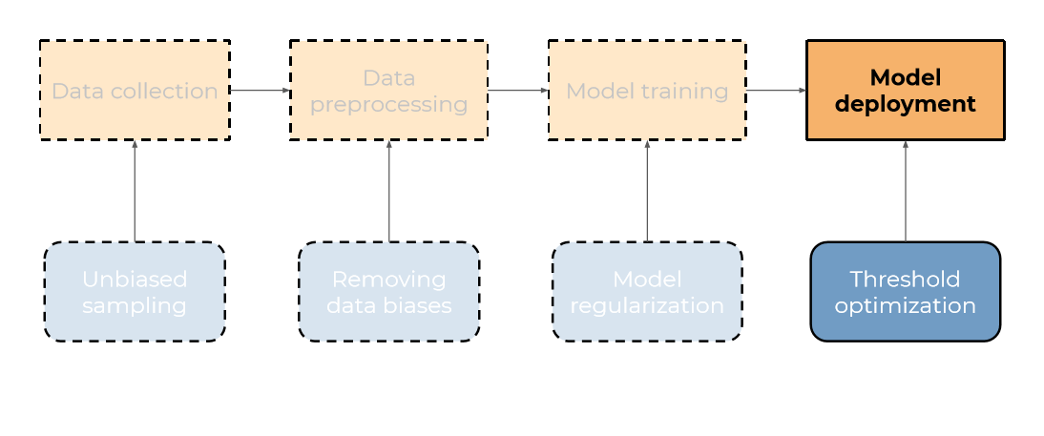
5.Ignoring biases in data and spending less time in data understanding

Slide 8
Skills which are new need for all AIML aspirants to break these misconceptions and avoid mistakes (In a service industry standpoint)
EDA and domain understanding is most needed , domain understanding is obviously a experience thing but research is the key
Balancing data collection is important
Getting feedback on your model performance and continuously improvement by acting fast with time is key to success of every model
Ignoring Cloud and big data is the big mistake know at least one cloud platform
Sometimes model performance is great however without explain ability it does not get implemented as client don’t risk their business
Some tools like Shap , Lime, Partial dependent plots , Eli5, skater and Dalax are few to try out .
Note : Product Industry mostly do focus on niche skills

Slide 9
Thank You

Slide 10
Q & A

